Slide 1

Code Refactoring and Bug Fixing

Slide 2
About me
I Pursuing B.Tech graduation passionate about data science
Developed strong problem-solving and analytical skills during academic journey
Fascinated by data science's ability to extract meaningful insights from complex datasets
Eager to contribute to impactful projects despite lacking prior work experience
Committed to continuous learning and staying updated with the latest advancements
LinkedIn profile: https://www.linkedin.com/in/sri-chaithanya-reddy-147000262/
GitHub projects: https://github.com/srichaithanyareddy
Open to exploring opportunities and making meaningful contributions in the field of data science.

Slide 3
Scenario:
A team of enthusiastic Data Scientists Embarked on am mission to develop a Note Taking Application Using Python , Flask, and HTML
However, their lack Of Experience in backend development has led to challenges in making the application fully functional
Recognizing Your proficiency In Backend Development, You have been Tasked with fixing the broken code and ensuring the application works seamlessly

Slide 4
Objective Of The Project:
Refactor the existing codebase and ensure the proper functioning of the Note Taking Application.
Document all Identified Bugs During the Debugging Process.
Remember, the Task is Not about Recreating the app from the Scratch Your Goal is to Fix the Already existing Codebase make the Application Work as Intended.

Slide 5
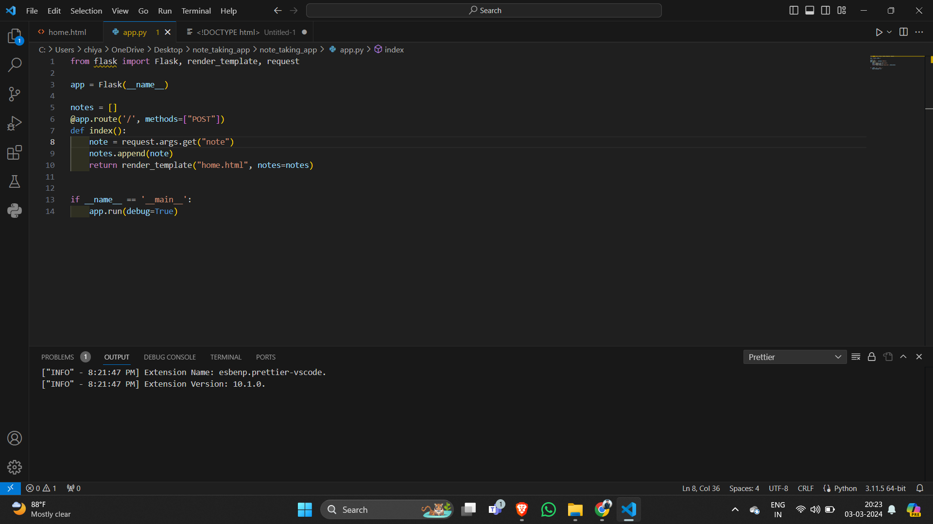
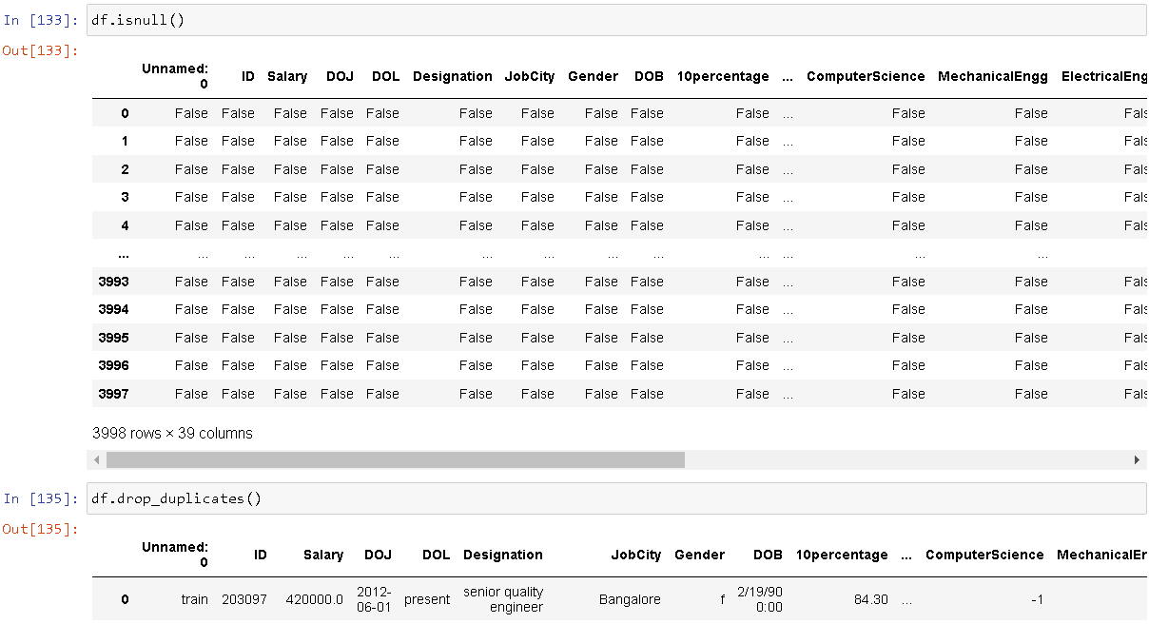
Identification of Bug in Application Server

Slide 6
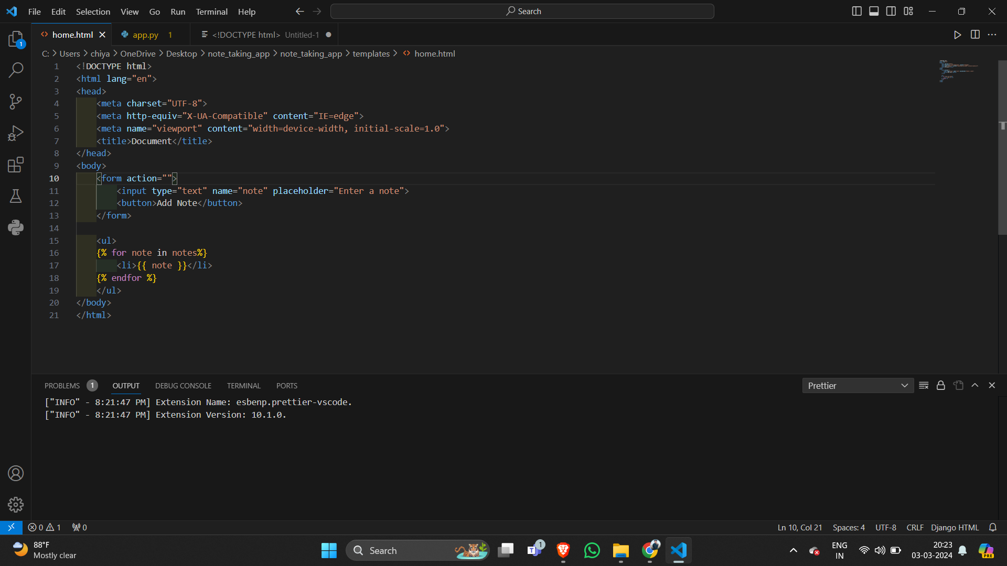
Identification of Bug in Html

Slide 7
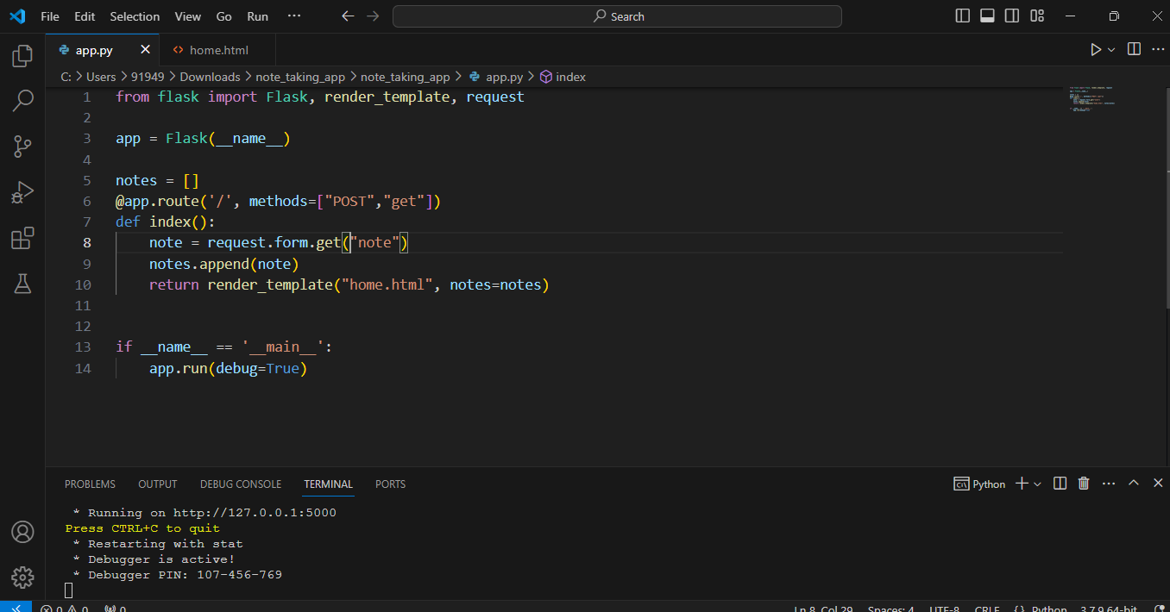
After Bug Fix in Application Server

Slide 8
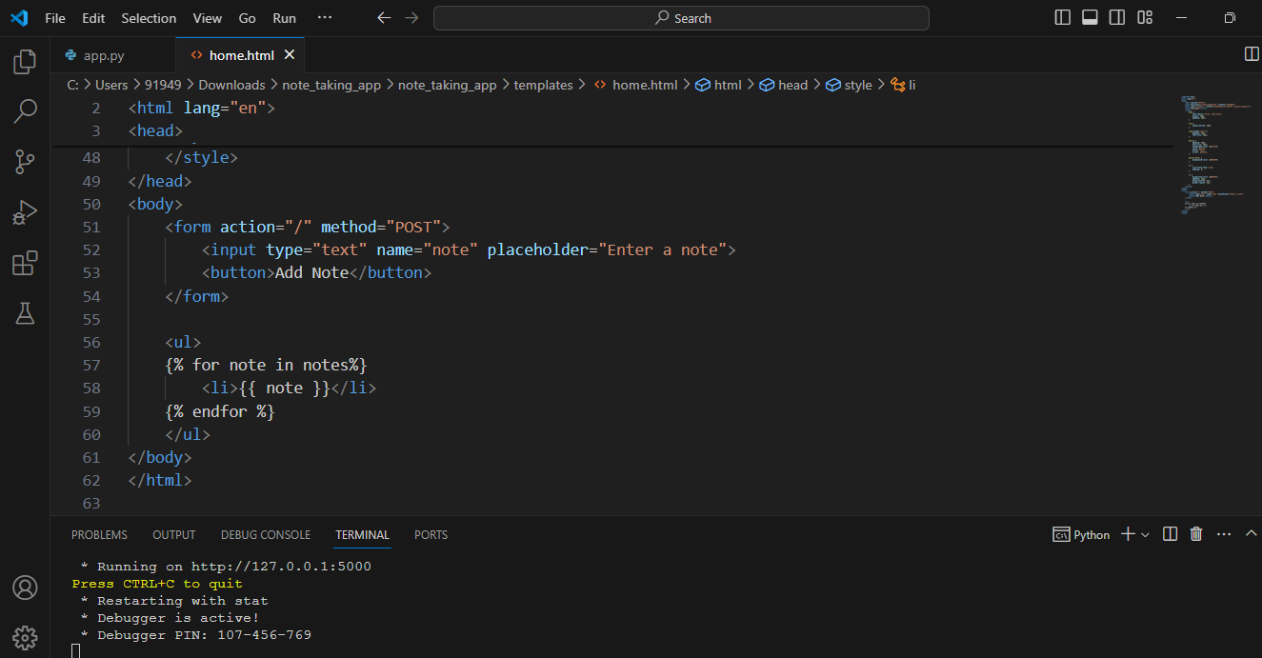
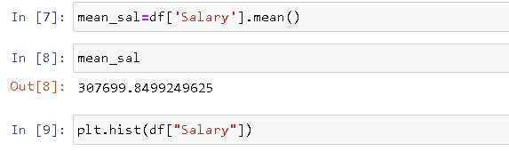
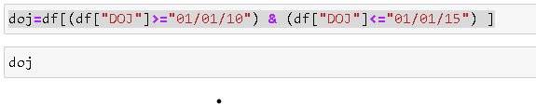
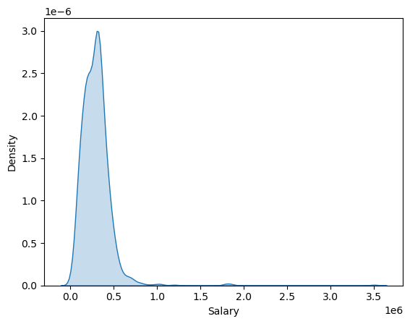
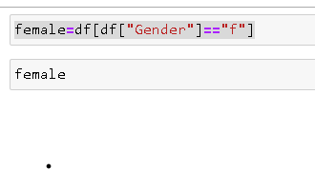
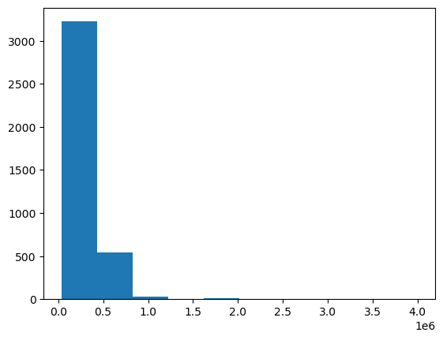
After Bug Fix in Html

Slide 9
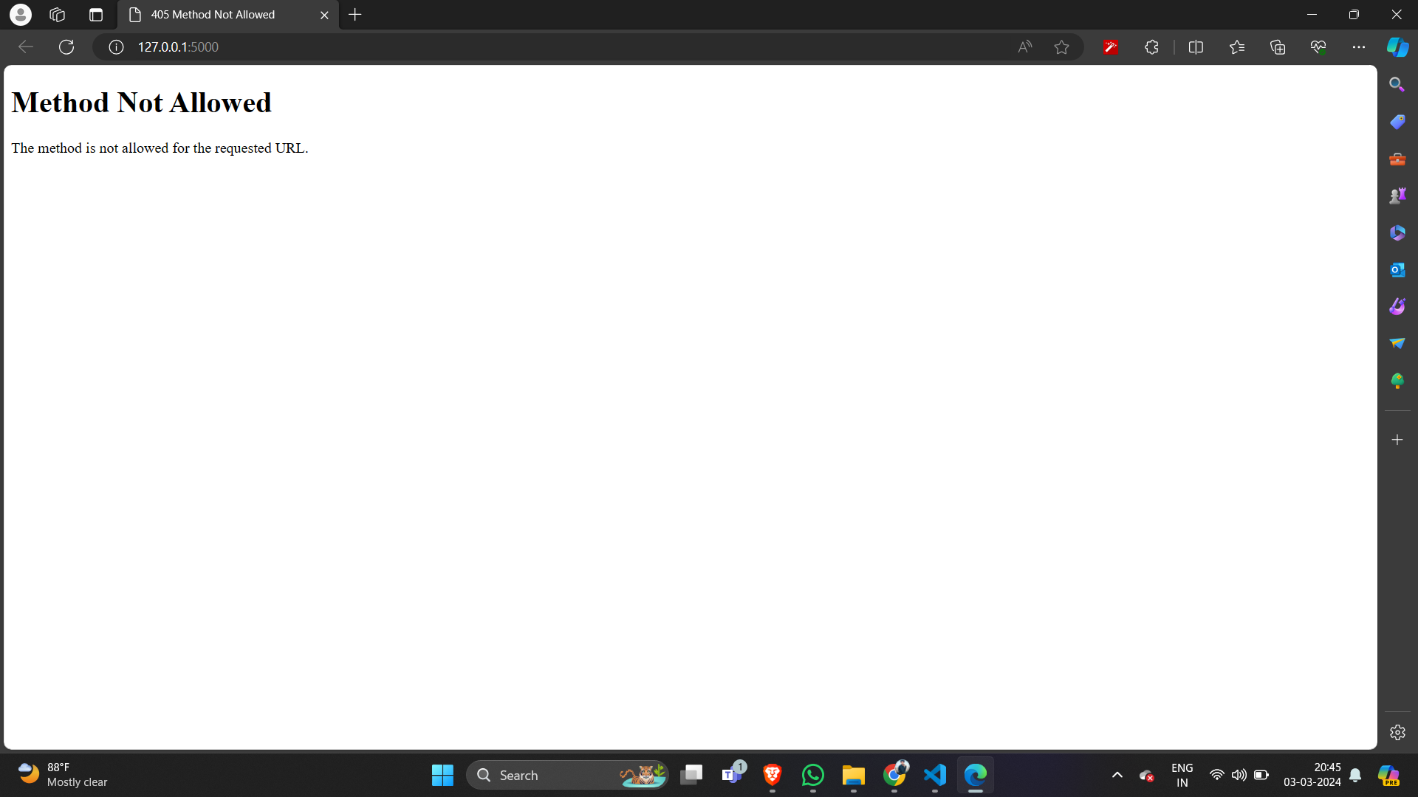
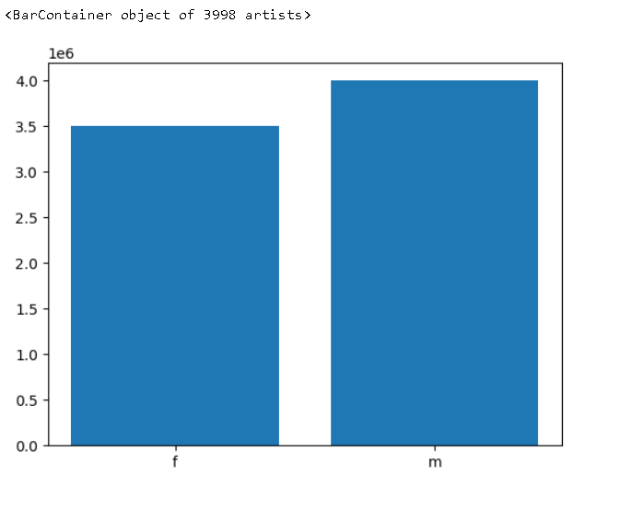
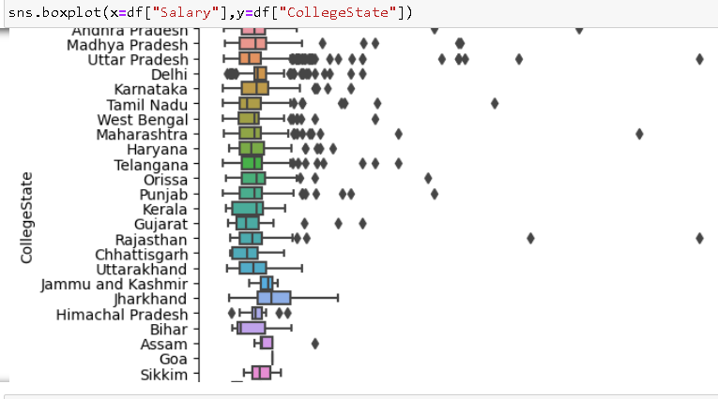
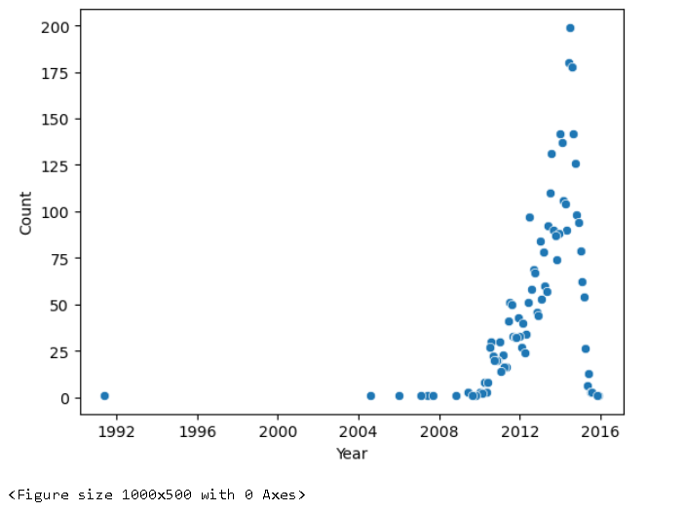
Output before fixing bugs

Slide 10
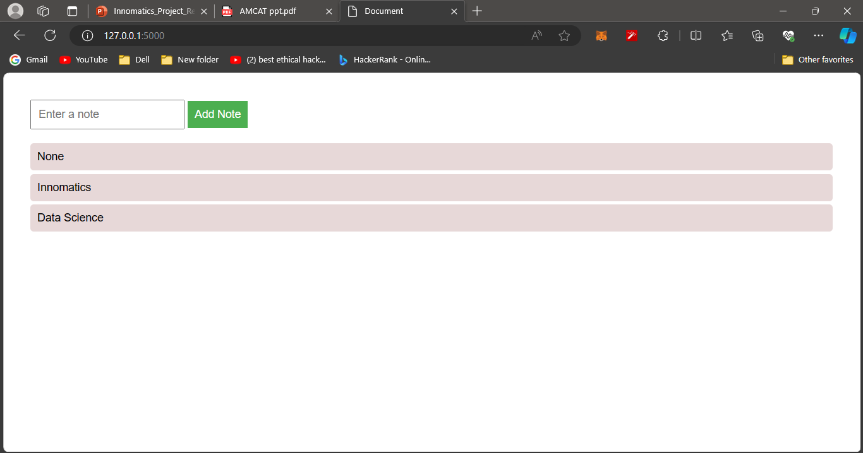
Output after fixing bugs

Slide 11
Conclusion
Key issues in our note-taking application have been successfully addressed, primarily focusing on the improvement of 'get' methods.
The provided code has undergone thorough refactoring, specifically targeting identified bugs within the 'get' methods.
Notable enhancements include better handling of empty notes, contributing to an overall smoother user experience.
The presentation emphasizes the importance of code refactoring to enhance the readability and maintainability of the 'get' methods.
These efforts aim to create a more robust and efficient implementation, ensuring the optimal performance of our note-taking application.

Slide 12

THANK YOU

